Slide 1

National University of Computer and Emerging Sciences,
Islamabad, Pakistan
Machine Learning Basics
CS-4025: Deep Learning for Perception
Dr. Noshina Tariq
Department of AI & DS

Slide 2
Course Materials
Will be shared via Google Classroom
Class Code
sr2pyool

Slide 3
Goals
What is learning?
What is machine learning?
Types of machine learning
Classification vs Regression

Slide 4
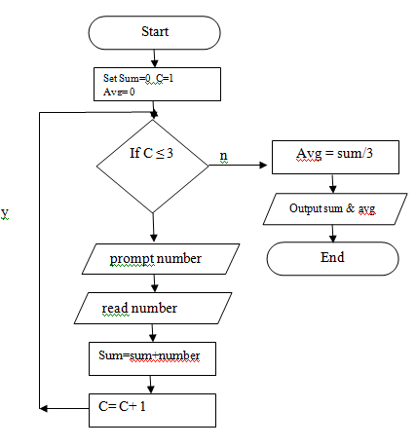
What is Learning?
How can we solve a specific problem?
We write a program with a set of rules that are useful to solve the problem.
Example: Find average of
three numbers

Slide 5
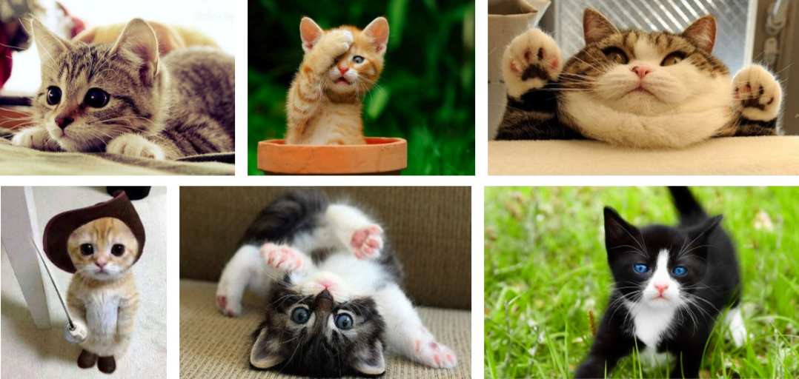
What is Learning?
In many situations it is very difficult to specify those rules to solve a problem.
For example, given a picture determine whether there is a cat in the image

Slide 6
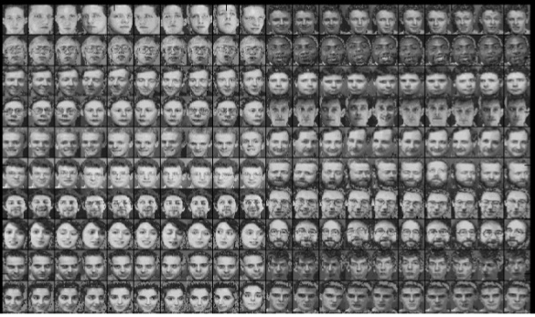
What is Learning?
Find face of a specific person?

Slide 7
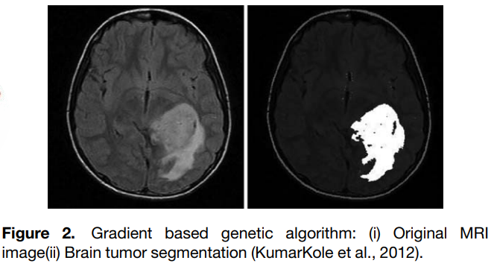
What is Learning?
Benign vs Malignant tumor

Slide 8
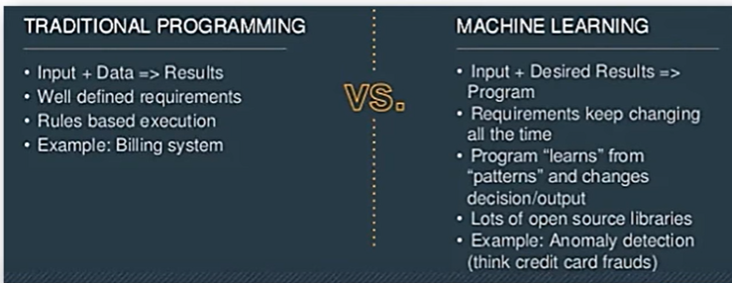

What is Learning?
Any learning systems are not directly programmed using conditions to solve a problem
Instead it should learn from examples (data)
From trial-and-error experience trying to solve the problem

Slide 9
What is Machine Learning?
Machine Learning is the science (and art) of programming computers so they can learn from data.
[Machine Learning is the] field of study that gives computers the ability to learn without being explicitly programmed.
Arthur Samuel, 1959

Slide 10
What is Machine Learning?
Machine learning can be defined as computational methods using experience to improve performance or to make accurate predictions.
Experience refers to the past information.
Mohri et al

Slide 11

What is Machine Learning?
Definition: “A computer program is said to learn from experience E with respect to some class of tasks T and performance measure P, if its performance at tasks in T, as measured by P, improves with experience E”
Tom M. Mitchel

Slide 12

A checkers learning problem
Task T: playing checkers
Performance measure P: percent of games won against opponents
Training experience E: playing practice games against itself

Slide 13
Spam Tagging Problem
Your spam filter is a Machine Learning program
Binary Classification Problem: spam emails or nonspam
To train a machine learning model, examples of emails that are spam and nonspam should be presented to the model
Usually flagged by users
The examples that the model uses to learn are called the training set.
Training instance (or sample).

Slide 14
Spam Tagging Problem
For Spam classification:
The task T is to flag spam for new emails
The experience E is the training data,
The performance measure P needs to be defined;
Percentage of correctly classified emails (accuracy)

Slide 15
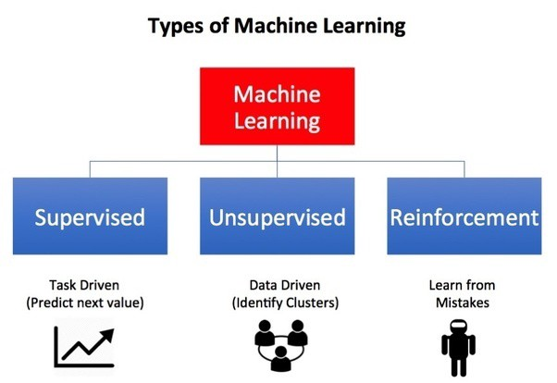
Types of Machine Learning…

Slide 16
Supervised learning
For supervised learning, we provide both data and labels for training the algorithm.
The algorithms learns from the data and labels
After training, we can pass test samples to check if the algorithm learned the data or not
Most popular in ML community

Slide 17
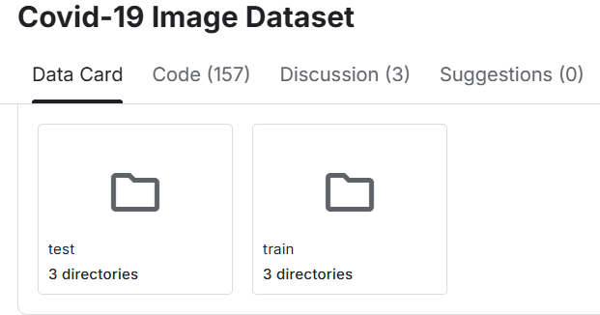
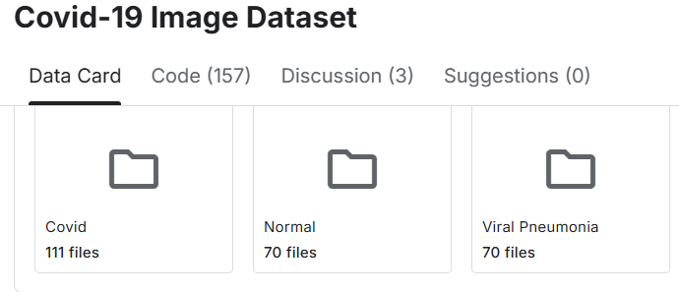
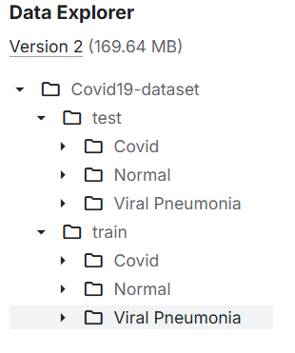
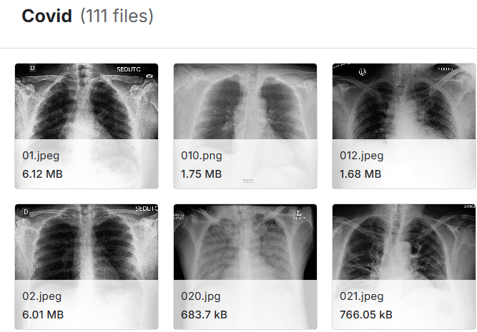
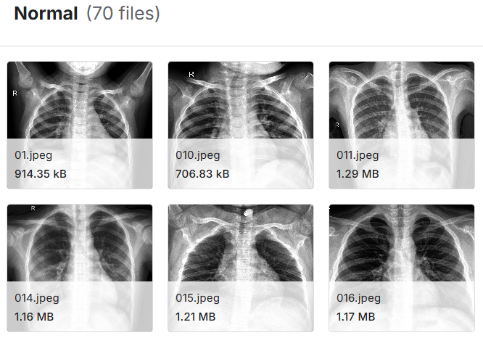
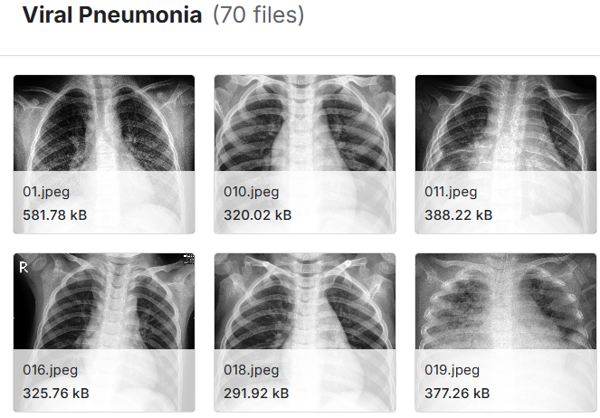
Supervised learning: Example

Slide 18
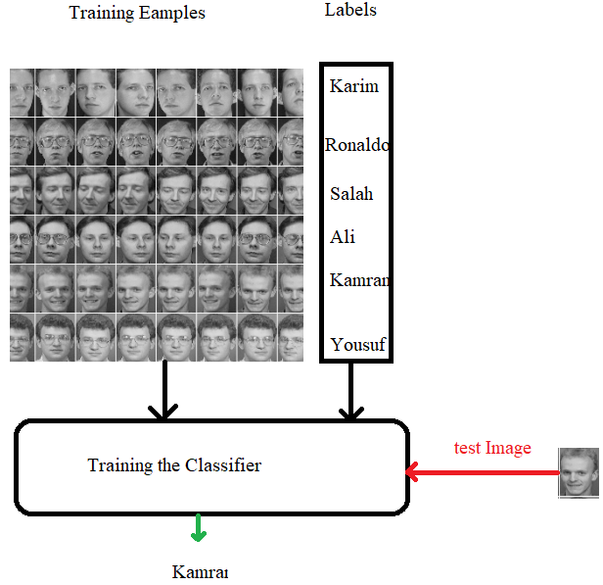
Supervised learning: Example

Slide 19
Supervised learning: Example
Supervised learning is widely used for tasks such as:
Classifying medical images.
Given a large datasets of images of malignant and benign tumors.
Translating between pairs of languages.
Pairs of sentences that have the same meaning in two different languages.
Detecting objects in a self-driving car.
Provide the model with examples of cars, pedestrians, etc.

Slide 20
Supervised Learning
Feature Space (X): Represents the attributes or characteristics that describe an object.
For example, in text classification, the features could be words in a document.
In biological classification, the features could be cell properties like shape, size, etc.
Label Space (Y): Corresponds to the categories or labels we assign to data points.
For example, in text classification, labels could be the type of article, such as "Sports", "News", or "Science".
For biological classification, the labels could be "Anemic cell" or "Healthy cell".
Discrete Labels: The labels are distinct and non-overlapping categories that the model aims to predict.
Example in Action:
Text Classification:
Feature Space (X): The words appearing in the document.
Label Space (Y): Categories like "Sports", "News", and "Science".
Cell Classification:
Feature Space (X): The properties of cells, such as shape, size, or structure.
Label Space (Y): Categories like "Anemic cell" or "Healthy cell".

Slide 21
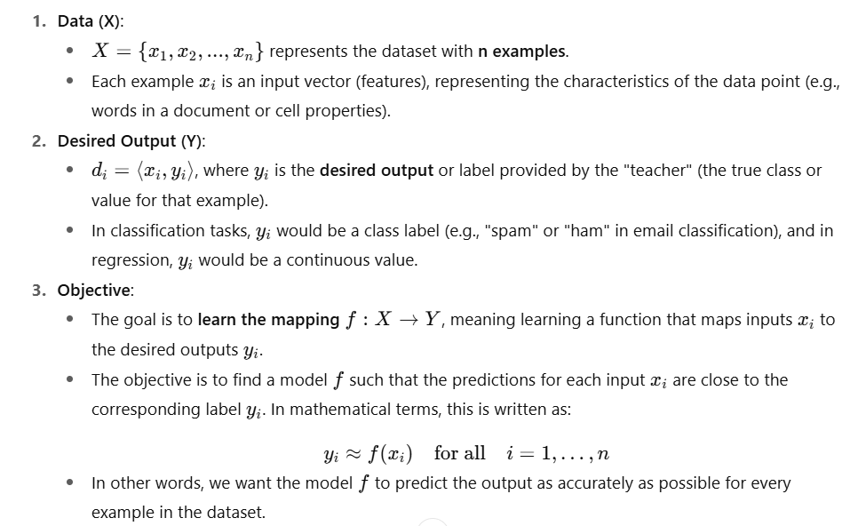
Supervised learning

Slide 22
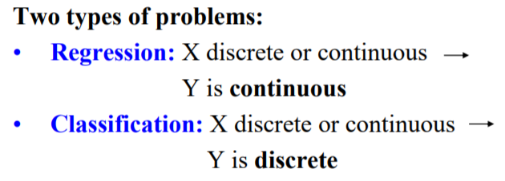
Supervised learning
Aspect | Regression | Classification
Output | Continuous (e.g., price, temperature, age) | Discrete (e.g., spam, disease, animal type)
Nature of Problem | Predicting numerical values based on input features | Predicting a category/label based on input features
Examples | Predicting house prices, stock prices, temperature | Email spam detection, disease diagnosis, object recognition
Algorithms | Linear Regression, Polynomial Regression, Random Forest | Logistic Regression, Decision Trees, SVM, Neural Networks
Use Cases | Quantitative analysis (e.g., sales forecasting) | Qualitative analysis (e.g., categorizing emails or images)

Slide 23
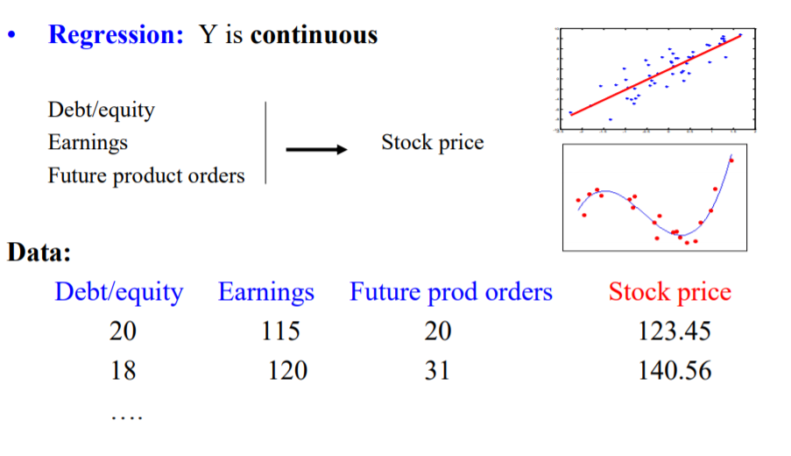
Supervised learning

Slide 24
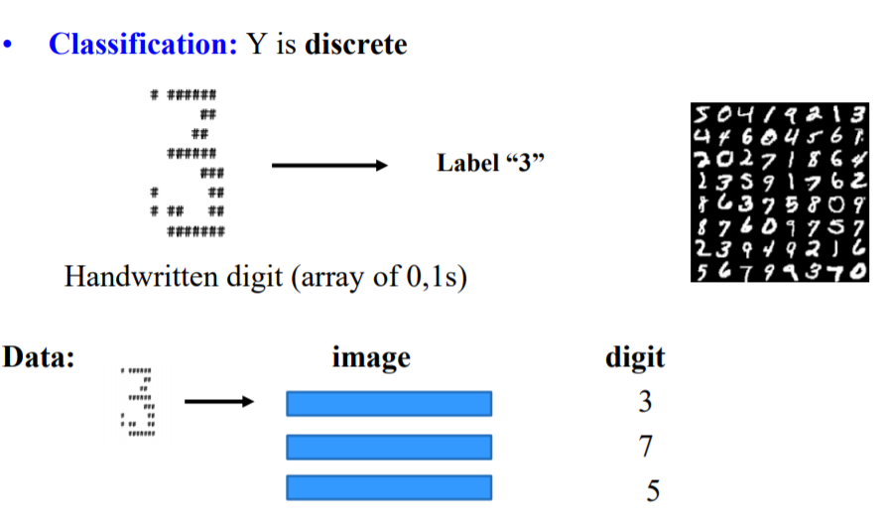
Supervised learning

Slide 25
Supervised learning
Can regression algorithms be used for classification and vice versa?
Yes, some algorithms can be used.
Logistic Regression is commonly used for classification
Predicts probability belonging to a class

Slide 26
Supervised learning
Some widely used supervised ML algorithms:
Linear Regression
Logistic Regression
Support Vector Machines (SVMs)
Decision Trees and Random Forests
Neural networks
k-Nearest Neighbors

Slide 27
Unsupervised learning
For unsupervised learning, we provide data but NOT labels for training the algorithm
The system tries to learn without a teacher.
Learns relations among data by itself
Then put the data into different groups/clusters

Slide 28
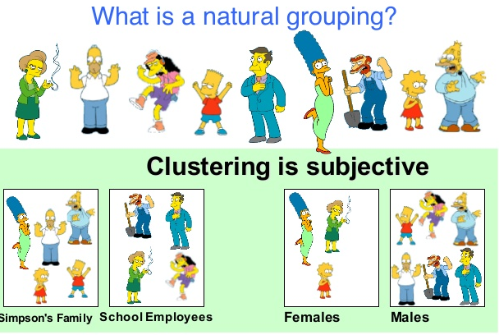
Unsupervised Learning

Slide 29
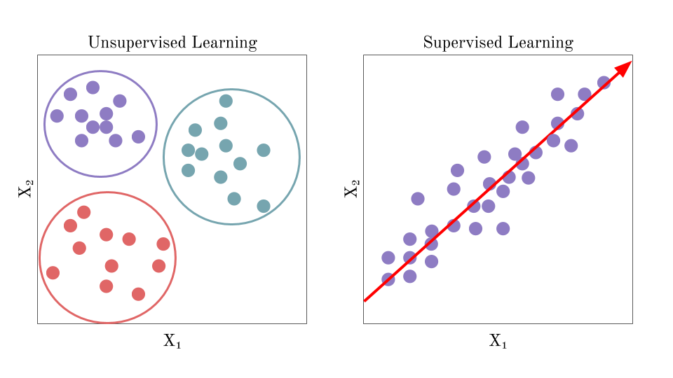
Unsupervised Learning

Slide 30
Unsupervised Learning
Some widely used unsupervised learning algorithms:
K-Means
Principal Component Analysis (PCA)
Apriori
Hierarchical Cluster Analysis (HCA)
One-class SVM

Slide 31
Usage of Unsupervised Learning
Data visualization
Dimensionality reduction
Clustering
Anomaly detection

Slide 32
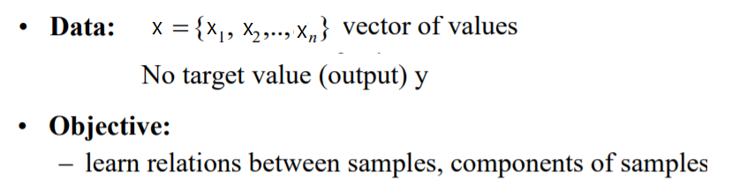
Unsupervised Learning

Slide 33
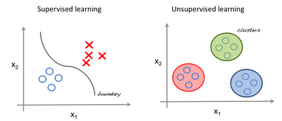
Supervised vs Unsupervised Learning
Labels: y

Slide 34
Reinforcement learning
The learning system, called an agent, can observe the environment, select and perform actions:
Get positive rewards for good actions
Get negative rewards for wrong action
Reinforcement learning refers to goal-oriented algorithms, which learn how to attain a complex objective (goal) or maximize

Slide 35
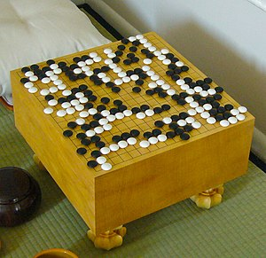
Reinforcement learning
It must then learn by itself what is the best strategy
Policy: best strategy
A policy defines what action the agent should choose when it is in a given situation.
Example:
Playing games, Robotics
Robots learn how to walk.
DeepMind’s AlphaGo

Slide 36
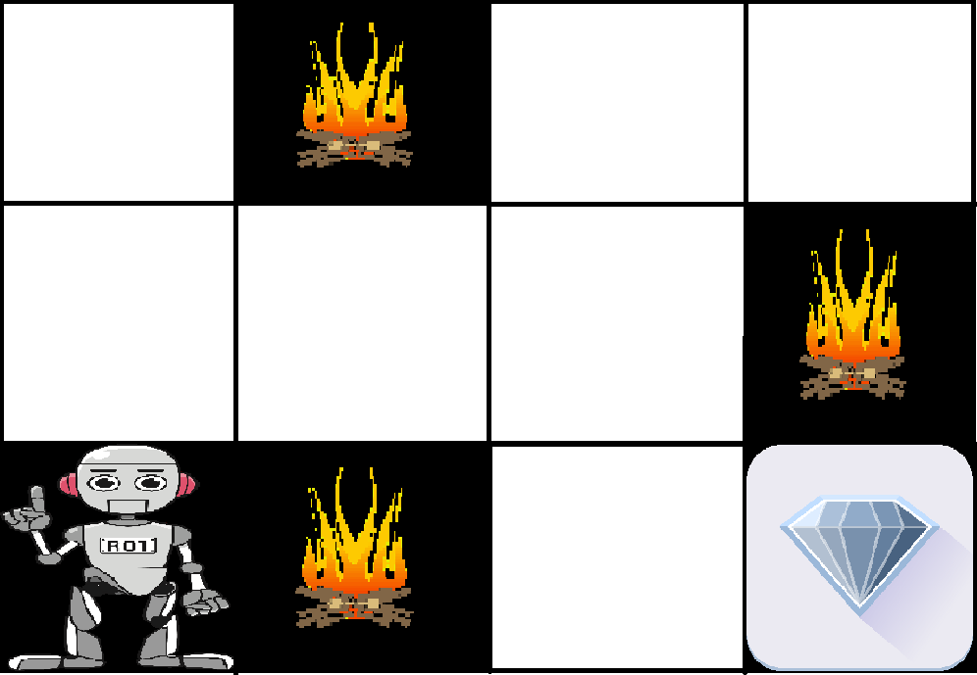
Reinforcement learning

Slide 37
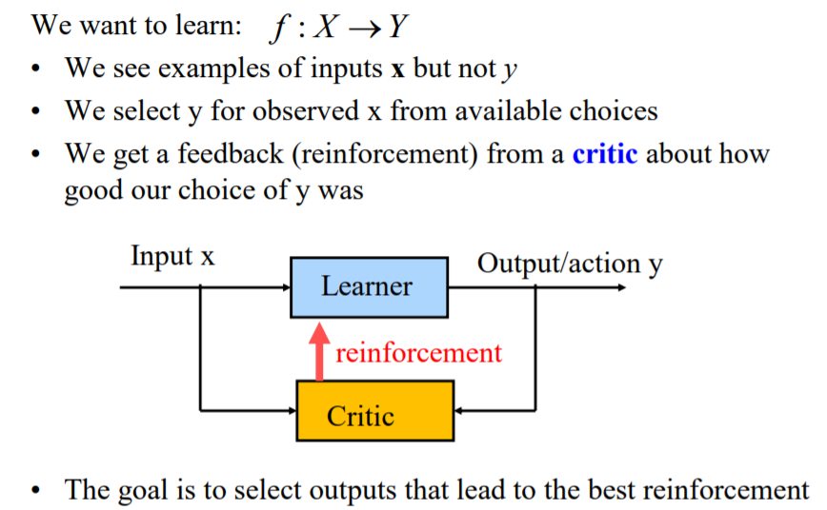
Reinforcement learning

Slide 38
Curiosity: Question of the Day
What if the data is changing, should we retrain the model from scratch?
Or anything else can be done?

Slide 39
Reference
Read 1st Chapter of Hands-on Machine Learning with Scikit-Learn, Keras, and TensorFlow- (2019)
https://towardsdatascience.com/workflow-of-a-machine-learning-project-ec1dba419b94
https://cloud.google.com/ai-platform/docs/ml-solutions-overview

Slide 40
Thank You ☺

